Slide 1
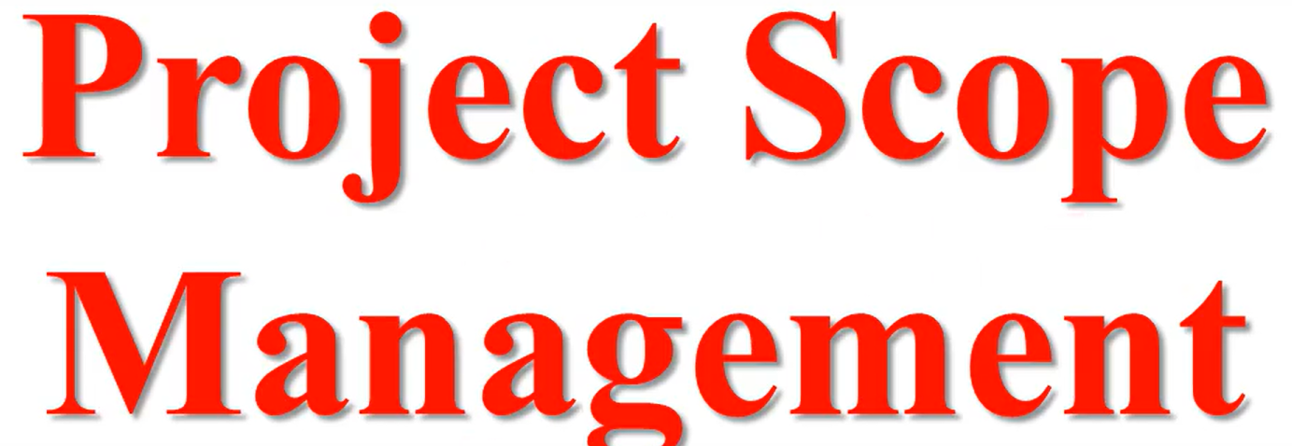
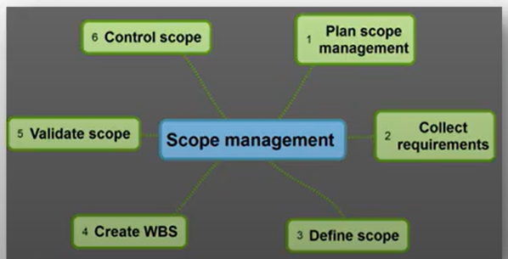

Slide 2
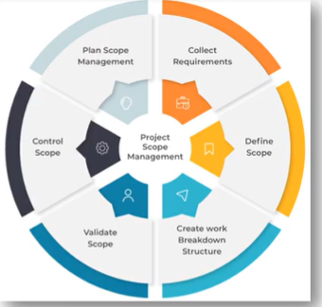
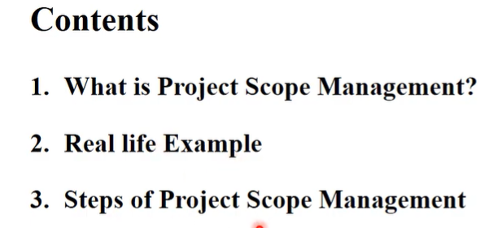

Slide 3
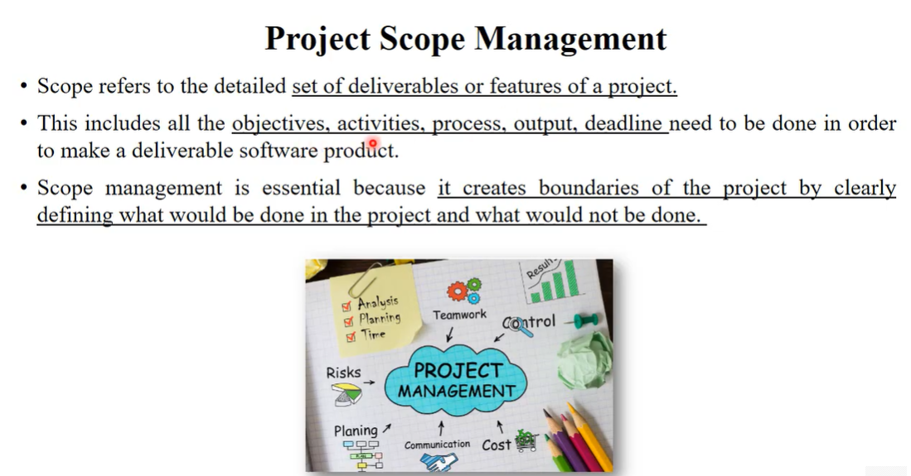

Slide 4
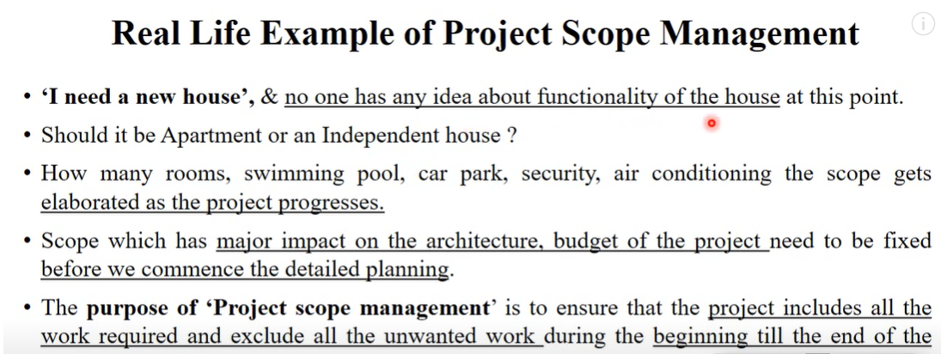

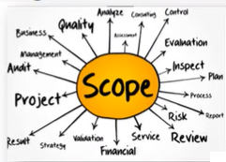

Slide 5
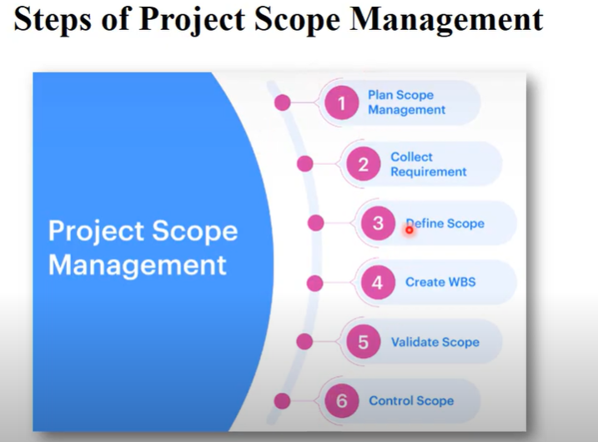

Slide 6
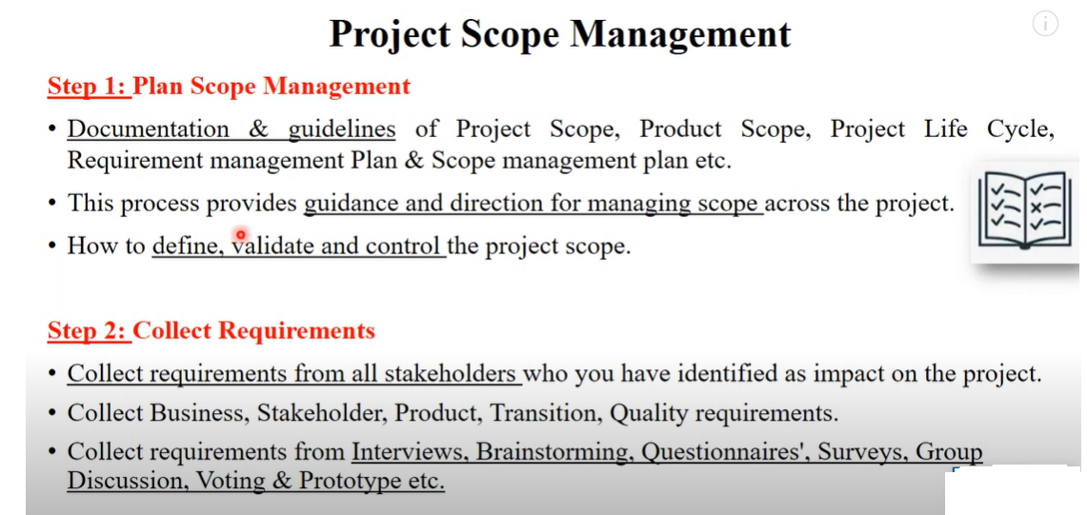

Slide 7
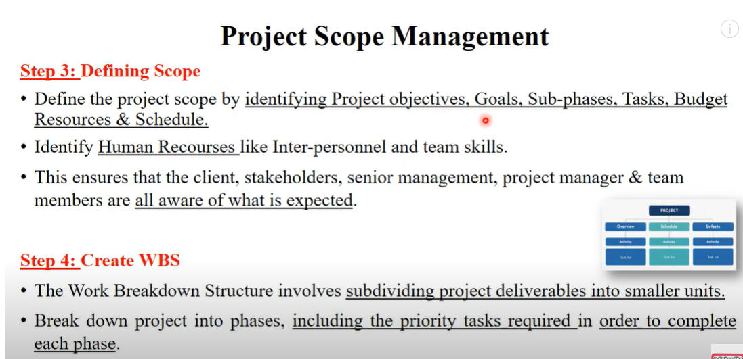

Slide 8
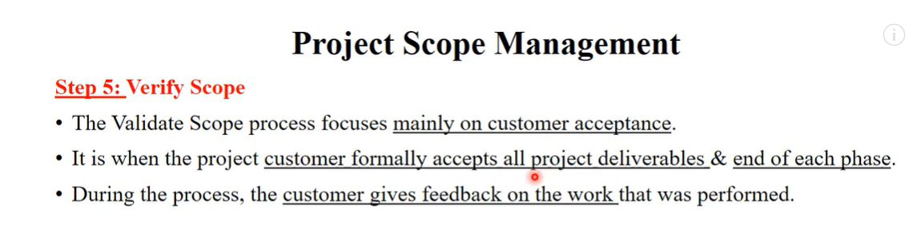

SE 28: Project Scope Management | Software Engineering

Slide 9
Scenario: Your project is almost complete, but several stakeholders are pushing for additional features that were not part of the original project scope. Adding these features would likely delay the project by a month.
Questions:
How would you handle these requests while keeping the project on track?
What measures would you implement to prevent scope creep in future projects?
Would you consider adjusting the project timeline or rejecting the additional features? Justify your decision.
SE 29: Work Breakdown Structure (WBS) with Examples

Slide 10
Scenario: The project has been delivered on time and within budget, but initial feedback from the client suggests that they are not satisfied with the product's usability and features.
Questions:
How would you handle this feedback to improve client satisfaction?
What steps would you take to ensure that similar issues do not occur in future projects?
Would you offer additional services or support to improve the usability of the product? Why or why not?

